Slide 1
CSEN20
Fall 2026
Introduction to Embedded Systems
Michael Schimpf, PhD, mschimpf@scu.edu

Slide 2
Chapter 10
Floating-Point Emulation

Slide 3



32-bit IEEE Floating-Point Format
Sign+Magnitude format:
0 if positive, 1 if negative
Excess-127 format
2⁰ → 01111111
Normalized (left-aligned): MS-Bit is always 1; never stored
31
30
23
22
0
±
Exponent
Significand (fractional bits)
8 bits
23 bits
Range: ≈ 2^{±127} ≈ 10^{±38}
Precision: 23+1 bits ≈ 7 decimal digits
Example: +1.0
0
0111 1111
000 0000 0000 0000 0000 0000
$$+$$
$2^{0}$=1
$$×$$
$$\left(1\right).000 0000 0000 0000 0000 0000=1.0$$

Slide 4
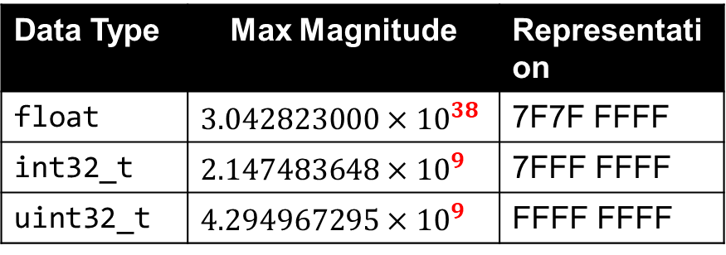
Greater Range than 32-bit Integers
Data Type | Max Magnitude | Representation
float | $$3.042823000×{10}^{38}$$ | 7F7F FFFF
int32_t | $$2.147483648×{10}^{9}$$ | 7FFF FFFF
uint32_t | $$4.294967295×{10}^{9}$$ | FFFF FFFF
29 orders of magnitude difference!

Slide 5
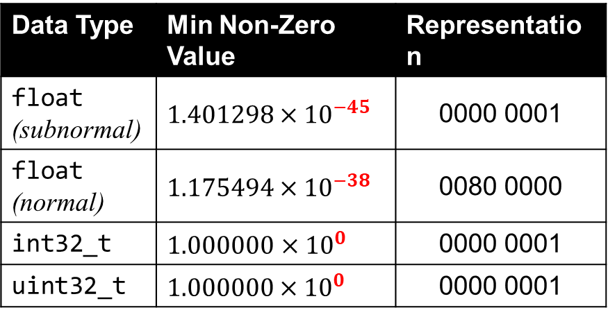
Greater Resolution than 32-bit Integers
Data Type | Min Non-Zero Value | Representation
float (subnormal) | $$1.401298×{10}^{−45}$$ | 0000 0001
float (normal) | $$1.175494×{10}^{−38}$$ | 0080 0000
int32_t | $1.000000$ $×{10}^{0}$ | 0000 0001
uint32_t | $$1.0\text{00000}×{10}^{0}$$ | 0000 0001
45 orders of magnitude difference!

Slide 6
Less Precision than 32-bit Integers
uint32_t u32 ;
float f32 ;
An exact representation requires 32 bits of precision
u32 = 2147483903 ;
1000 0000 0000 0000 0000 0000 1111 1111
24 bits
8 bits
discarded
f32 = (float) u32 ;
0
1001 1110
000 0000 0000 0000 0000 0000
${+1.0×2}^{31}$= 2,147,483,648.0
7 decimal digits (23+1 bits) of precision
u32 = (uint32_t) f32 ;
1000 0000 0000 0000 0000 0000 0000 0000
printf(“u32=%u\n”), u32) ; 2147483648

Slide 7



Interpreting 32-bit IEEE Float
exponent?
$$exp=00000000$$
$$exp=11111111$$
$00000001≤exp≤$ 11111110
Remove excess-127 bias:
$$exp←\left(uint8_t\right)\exp{− 127}$$
significand?
significand?
Add hidden bit:
$$sig←1.sig$$
$$sig=0$$
$$sig ≠ 0$$
$$sig=0$$
$$sig≠ 0$$
Zero
Subnormal
Normal
Infinity
Not a Number
$$±0.0$$
$$±0.sig×2^{−126}$$
$$±1.sig×2^{exp}$$
$$±∞$$
$$±NaN$$
(underflow)
(overflow)
($÷0;\sqrt{<0}$)

Slide 8
Arithmetic Processing
special case?
$$extract signs, exponents \\ \& significands$$
$$prealign operands$$
$$yes$$
$$perform arithmetic$$
$$add guard, rounding, \\ and sticky bits$$
$$result←table lookup$$
$$normalize result$$
$apply rounding$ & post-normalization
$$assemble result^{′}s sign \\ exponent \& significand$$
$$check for overflow \\ \& underflow$$

Slide 9
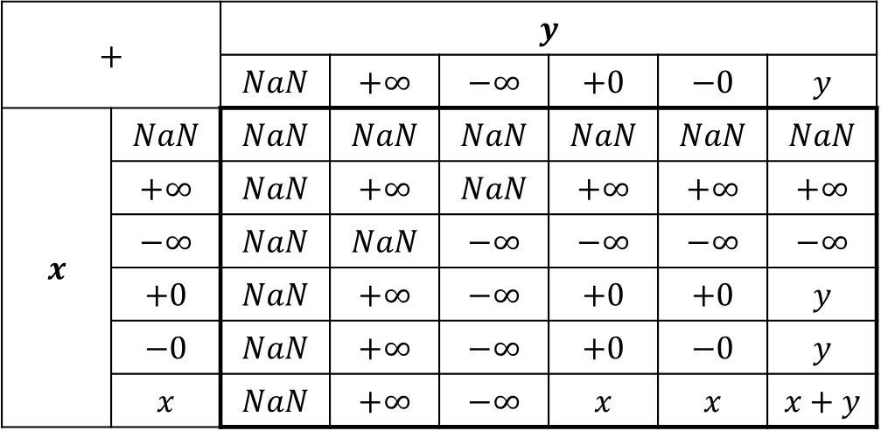
Special Case Handling: Addition
$$+$$ |  | $$y$$
 |  | $$NaN$$ | $$+∞$$ | $$−∞$$ | $$+0$$ | $$−0$$ | $$y$$
$$x$$ | $$NaN$$ | $$NaN$$ | $$NaN$$ | $$NaN$$ | $$NaN$$ | $$NaN$$ | $$NaN$$
 | $$+∞$$ | $$NaN$$ | $$+∞$$ | $$NaN$$ | $$+∞$$ | $$+∞$$ | $$+∞$$
 | $$−∞$$ | $$NaN$$ | $$NaN$$ | $$−∞$$ | $$−∞$$ | $$−∞$$ | $$−∞$$
 | $$+0$$ | $$NaN$$ | $$+∞$$ | $$−∞$$ | $$+0$$ | $$+0$$ | $$y$$
 | $$−0$$ | $$NaN$$ | $$+∞$$ | $$−∞$$ | $$+0$$ | $$−0$$ | $$y$$
 | $$x$$ | $$NaN$$ | $$+∞$$ | $$−∞$$ | $$x$$ | $$x$$ | $$x+y$$
Source: S. K. Raina, "FLIP: A Floating-Point Library for Integer Processors", Laboratoire de l'Informatique du Parallélisme, Sept. 12, 2006

Slide 10
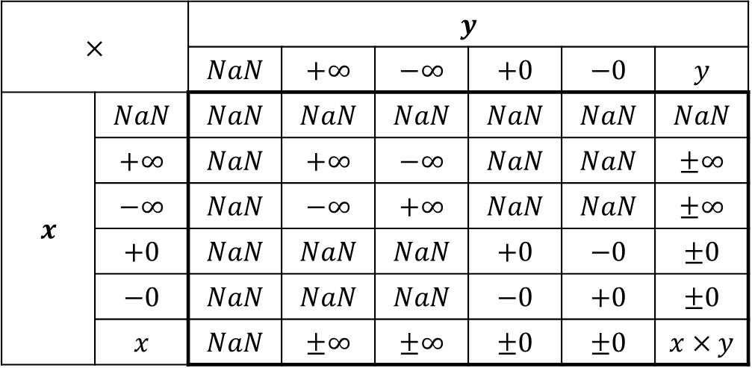
Special Case Handling: Multiplication
$$×$$ |  | $$y$$
 |  | $$NaN$$ | $$+∞$$ | $$−∞$$ | $$+0$$ | $$−0$$ | $$y$$
$$x$$ | $$NaN$$ | $$NaN$$ | $$NaN$$ | $$NaN$$ | $$NaN$$ | $$NaN$$ | $$NaN$$
 | $$+∞$$ | $$NaN$$ | $$+∞$$ | $$−∞$$ | $$NaN$$ | $$NaN$$ | $$±∞$$
 | $$−∞$$ | $$NaN$$ | $$−∞$$ | $$+∞$$ | $$NaN$$ | $$NaN$$ | $$±∞$$
 | $$+0$$ | $$NaN$$ | $$NaN$$ | $$NaN$$ | $$+0$$ | $$−0$$ | $$±0$$
 | $$−0$$ | $$NaN$$ | $$NaN$$ | $$NaN$$ | $$−0$$ | $$+0$$ | $$±0$$
 | $$x$$ | $$NaN$$ | $$±∞$$ | $$±∞$$ | $$±0$$ | $$±0$$ | $$x×y$$
Source: S. K. Raina, "FLIP: A Floating-Point Library for Integer Processors", Laboratoire de l'Informatique du Parallélisme, Sept. 12, 2006

Slide 11
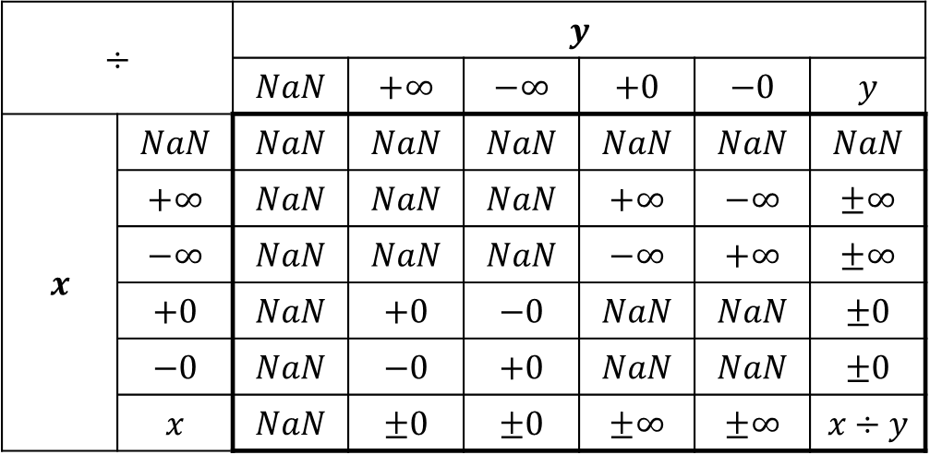
Special Case Handling: Division
$$÷$$ |  | $$y$$
 |  | $$NaN$$ | $$+∞$$ | $$−∞$$ | $$+0$$ | $$−0$$ | $$y$$
$$x$$ | $$NaN$$ | $$NaN$$ | $$NaN$$ | $$NaN$$ | $$NaN$$ | $$NaN$$ | $$NaN$$
 | $$+∞$$ | $$NaN$$ | $$NaN$$ | $$NaN$$ | $$+∞$$ | $$−∞$$ | $$±∞$$
 | $$−∞$$ | $$NaN$$ | $$NaN$$ | $$NaN$$ | $$−∞$$ | $$+∞$$ | $$±∞$$
 | $$+0$$ | $$NaN$$ | $$+0$$ | $$−0$$ | $$NaN$$ | $$NaN$$ | $$±0$$
 | $$−0$$ | $$NaN$$ | $$−0$$ | $$+0$$ | $$NaN$$ | $$NaN$$ | $$±0$$
 | $$x$$ | $$NaN$$ | $$±0$$ | $$±0$$ | $$±∞$$ | $$±∞$$ | $$x÷y$$
Source: S. K. Raina, "FLIP: A Floating-Point Library for Integer Processors", Laboratoire de l'Informatique du Parallélisme, Sept. 12, 2006

Slide 12
Special Case Handling Determining Lookup Table Index
no
no
no
$$−126≤exp≤+127$$
?
$$\left|f\right|=0000⋯0?$$
$$\left|f\right|=7F80⋯0?$$
$$±0$$
$$±∞$$
$$sign bit?$$
$$sign bit?$$
$$0$$
$$0$$
normal or subnormal
$$1$$
$$1$$
$$NaN$$
$$−0$$
$$+0$$
$$−∞$$
$$+∞$$
$$index←5$$
$$index←4$$
$$index←3$$
$$index←2$$
$$index←1$$
$$index←0$$

Slide 13
Guard, Round & Sticky Bits
24-bit significand
G
R
S
$$0$$
e$xp=0$
1.000 0000 0000 0000 0000 0000
0
0
0
+
$$0$$
e$xp=−23$
1.100 1000 0000 0000 0000 0000
0
0
0
27-bit operand
(alignment)
$$0$$
e$xp=0$
1.000 0000 0000 0000 0000 0000
0
0
0
+
$$0$$
e$xp=0$
0.000 0000 0000 0000 0000 0001
1
0
1
(addition)
once set, stays set
$$0$$
e$xp=0$
1.000 0000 0000 0000 0000 0001
1
0
1
used for rounding

Slide 14
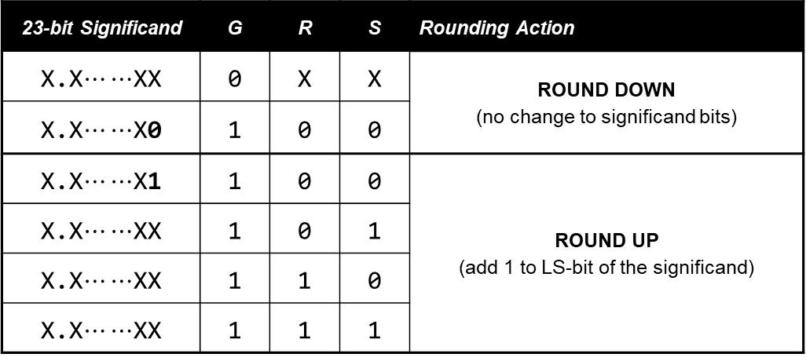
Round to Nearest Even
23-bit Significand | G | R | S | Rounding Action
X.X$⋯⋯$XX | 0 | X | X | ROUND DOWN (no change to significand bits)
X.X$⋯⋯$X0 | 1 | 0 | 0
X.X$⋯⋯$X1 | 1 | 0 | 0 | ROUND UP (add 1 to LS-bit of the significand)
X.X$⋯⋯$XX | 1 | 0 | 1
X.X$⋯⋯$XX | 1 | 1 | 0
X.X$⋯⋯$XX | 1 | 1 | 1

Slide 15
Normalization
$$0$$
e$xp=0$
1.000 0000 0000 0000 0000 0000
+
$$0$$
e$xp=0$
1.000 0000 0000 0000 0000 0000
(addition)
$$0$$
e$xp=0$
10.000 0000 0000 0000 0000 0000
(normalization)
$$0$$
e$xp=+1$
1.000 0000 0000 0000 0000 0000

Slide 16
Done

